Slide 1
A life of prayer
Q/A: 116-129

Slide 2
What is prayer?
Prayer is the most important exercise of our faith and the way in which we daily receive God's benefits.
Prayer is the surest witness of a someone’s conversion, evidence that the Holy Spirit has put spiritual life into the heart of that person.
Prayer is a response from our hearts towards God – an outpouring and expression of internal feeling before God – prompted by the work of God the Holy Spirit within us.

Slide 3
Why should we pray?
Prayer shows our dependence on God for all things.
Prayer helps our hearts to keep desiring and seeking God as we develop habits to seek God in every hour of necessity.
Prayer helps us to keep shameful and sinful desires out of our minds.
Prayer prepares us to receive the good things which God has in store for us with true gratitude and thanksgiving since our prayers remind us that all things come from God’s hand.
Prayer also helps believers to long more earnestly for God’s favour and have greater pleasure in receiving the blessings which have been obtained through prayer.
Prayer confirms the thought of providence in the minds of believers, helping us to see that God’s promises will never fail.

Slide 4
In what manner should we pray?
From the heart - an outpouring and expression of internal feeling before God .
Acknowledging sin – know that we are sinful people who deserve only God's wrath.
Confident in Christ – because we belong to Christ and for the sake of Christ, God will most certainly hear our prayer.

Slide 5
How should we pray?
Matthew 6:1-14
This is a model for what our prayers should look like, not words to be merely formally repeated.

Slide 6
Our Father in heaven
True prayer begins with a relationship with the true God.
God has become our father through Christ.
God, the Almighty King who reigns over all things, can be approached as we would approach a father with a request.

Slide 7
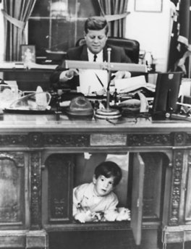
Our Father in heaven
Just like JF Kennedy's son had access to his father, POTUS.
Because of Christ we can come to God as our Father, trusting and knowing that he will not turn us away.

Slide 8
Hallowed be your name
God's glory should be the ultimate focus of our lives and prayers.
We must pray that God would receive the honour, reverence, worship and praise to which he is entitled.
We should pray that in our lives, thoughts, words and actions – God's name would be glorified.

Slide 9
Your kingdom come
The church is the fruit of God's kingdom – the place where God is recognised as king.
We should pray that in our own lives, God would rule us by his Word and Spirit.
We should pray that God will preserve and grow the church.
We should pray that all things/people/powers that set themselves up against God will be destroyed.

Slide 10
Your will be done on earth as in heaven
God's kingdom comes as people through the Word and the Spirit are brought to obedience of faith.
Pray that God through his Spirit will help us to be obedient to God's Word.
Pray that our churches likewise will be obedient to God's Word.
Pray that all people will be obedient to God and acknowledge him as king, just as in heaven God is acknowledged and obeyed by all.

Slide 11
Notice:
Petition 1: God's name to be hallowed
Petition 2: God's kingdom to come
Petition 3: God's will to be done
All three petitions are concerned with God.
If we model our prayers on the Lord's prayer – make sure that your prayers are primarily concerned with God and his glory, and not your wants and desires.

Slide 12
Give us our daily bread
Bread – basic need for us to live
We need to put our trust in God to provide the most basic and necessary things for our life. Notice – not a request for a horse or big house – but only for that which is necessary, not for that which is not.
Way in which God provides [Commandment 7] – not 'something for nothing' – but through work.

Slide 13
Forgive us our sins as we forgive those who sin against us
Living a life of gratitude in response to God's salvation means that we will forgive those who sin against us, because we know we have been forgiven by God when we sin against him.
Do not think you have been forgiven by God if you cannot forgive your brother or sister who has wronged you.
Pray for God to help us forgive those who wrong us.

Slide 14
And lead us not into temptation but deliver us from evil
We have been rescued from the power of sin through regeneration and indwelling of the Holy Spirit.
Prayer shows we recognise our weakness – ask God not to bring us into situations where we will be tempted and fall.
Prayer also shows we recognise that because of the Holy Spirit living in us, we can resist our sinful nature and obtain victory over sin.

Slide 15
Notice:
Petition 4: God to provide for our material needs
Petition 5: God to help us love and forgive our neighbour
Petition 6: God to help us fight sin and be conformed into the image and likeness of Jesus
All three petitions recognise a need for God to help us.
Physically (food), relationally (people) and spiritually (fight against sin).

Slide 16
For yours is the kingdom, the power and the glory, for ever and ever, Amen.
God has power over all things
God is ultimately in charge of the world
God is willing and able to give good to us
We pray these things because we trust they are God's will and will bring honour to God
We say Amen – knowing that our prayer is truly and surely heard by God, even more than I feel in my heart that I desire these things from him

Slide 17
Would it be right to pray for the following?
Avoidance of a speeding ticket?
A lottery win?
Excellent results in an exam when I have not studied/worked hard to merit them?
For my sports team to win?
For healing from sickness/deliverance from suffering? Where would such a prayer fit within the Lord's prayer?

Slide 18
Questions
What is the proper attitude with which we should approach God in prayer?
Will God give us anything we ask for?
What do the first three petitions teach us about prayer?
What is involved in forgiving those who sin against us?
Why does God sometimes not give us the things we ask for?

Slide 19
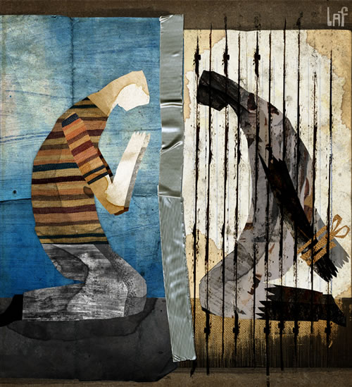
RC BULT Church Prayer Meeting
We have another church prayer meeting next week Sunday, so there won't be a Catechism class then.
10:00-11:00 here in the G5 coffee room.
It will be a good chance to put into practice what we have learned today about prayer as we pray for God’s work IN, ON and OVER RC Bult – and as preparation for the Lord’s Supper taking place on Sunday 5 June.

Slide 20
Doxology - Praise
Praise God, from whom all blessings flow;
Praise Him, all creatures here below;
Praise Him above, ye heav’nly host;
Praise Father, Son, and Holy Ghost!

Slide 21
Doxology
Know that the Lord our God is good;
his mercy is forever sure;
his truth at all times firmly stood,
and shall from age to age endure.

Slide 22
Next Catechism Class
Sunday 5 June
Recap of the Heidelberg Catechism
Any other questions…
Each person get the chance to, in language of preference, recite the answer to the first question of the Catechism in front of the class.
LONGER class – 09:30-11:00

